Slide 1
Markets &
Market Mechanism
INFO 4220 – Networks II: Market Design

Slide 2
Today
We will talk about what defines a market
Discuss how transactions are typically arranged
And see a few examples in which cases it doesn’t work
We will then talk about game theory and why it is important for market design

Slide 3
What is a Market?
You have a collection of buyers that want to buy something (for example, oranges)
And a collection of sellers that want to sell that something (for example, oranges)
Markets are the institutions where buyers and sellers meet to agree on a price (market for oranges)
We are going to start looking at how prices are determined in perfectly competitive markets
  Then see what happens in less traditional markets
  And then what happens in less common markets

Slide 4
Prices & Markets
Typical transactions are based on prices:
  Prices are the signal that agents use to evaluate tradeoffs
When thinking in economic terms, we are always talking about tradeoffs (for example, exchanging money for a product/service)
  I give away my money for a bag of oranges, do I value a bag of oranges more than they money I paid for it?
In market economies, prices are determined by interactions between consumers and producers
  These interactions happen in markets

Slide 5
Extent of a Market
In markets, it is necessary to define what are the boundaries
  What are the products?
  Who are the customers?
  Where is it being sold?
  How is it being sold?
What is TikTok’s market?
What is Amazon’s market?

Slide 6
TikTok’s Market
It’s complicated:
  Their revenue comes from advertising. Advertisers pay to show you ads. Ads are sold to highest bidder
  You spend time on TikTok because you want to see entertaining videos
    You are paying with your “labor” of watching ads
    You are also paying with your data, which TikTok mines while you use the app, and that TikTok use to increase the value of showing ads to you
  You could also post videos on TikTok and get paid for your content. Most people post videos and don’t get paid

Slide 7
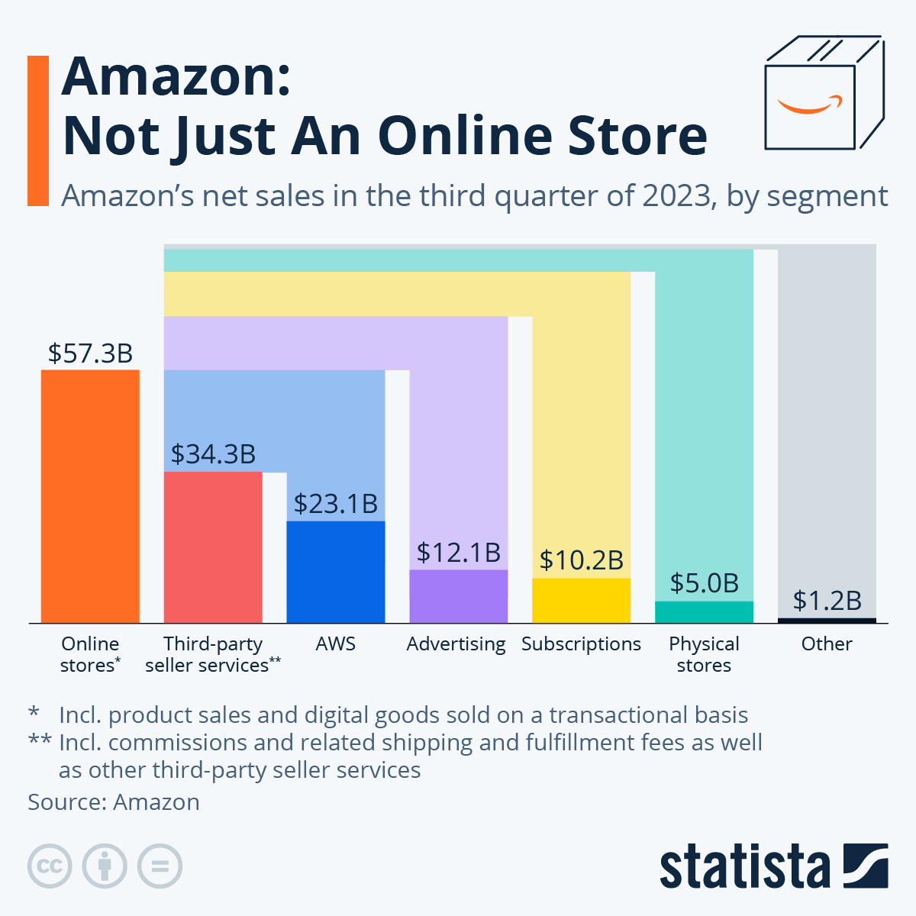
https://www.statista.com/chart/15917/amazon-revenue-by-segment/

Slide 8
Extent of a Market
Critical definition in antitrust law: What is the market? Is the firm harming consumers in the market?
Current US antitrust law is based on prices and consumer harm
How do you say Google is a monopoly that harms consumers if their products and services are free
Recent antitrust lawsuits against Google:
  Is based on the display advertising business
  Claims Google abuses its power and as a result:
    Websites that rely on Google ads revenue earn less than they should
    Advertisers end up paying more than they would, and those cost are eventually passed down to consumers

Slide 9
Why the DOJ says Google Abuses its Power (on display ads)
Google already lost a case about search and keyword ads
This lawsuit is about display advertising, not search ads (or ads you would see in YouTube, Gmail…)
Publishers (i.e. websites) use Google’s ad-tech stack to sell advertising space (banner ads)
Google controls the supply side (publishers), the advertising exchange (where ad buyers and ad sellers buy/sell ads), and the demand side (advertisers)
There is competition in all these segments, but Google offers much worst conditions to publishers that don’t use their supply side platform, and advertisers that don’t use their demand side platform

Slide 10
Why Google says they are not operating a monopoly
They challenged the DOJ’s definition of a market
  The DOJ says banner ads on websites (display ads) are a market on itself
  Google wants a broader definition; in that way they can say only a small share of online ads goes through them
They say there is competition on all segments of the market and that their practices benefit customers:
  Their end-to-end integration offers safety and lower fees
  There is hyper competition from header bidding
  DOJ says: But why offer worst conditions to those that don’t use end-to-end integration; and why are they trying to kill header bidding

Slide 11
Supply and Demand
A thick market is a market where there are many buyers and sellers
Without intervention, supply and demand will come to an equilibrium that determines prices and quantities to be traded
The model of supply and demand is the workhorse of economics

Slide 12
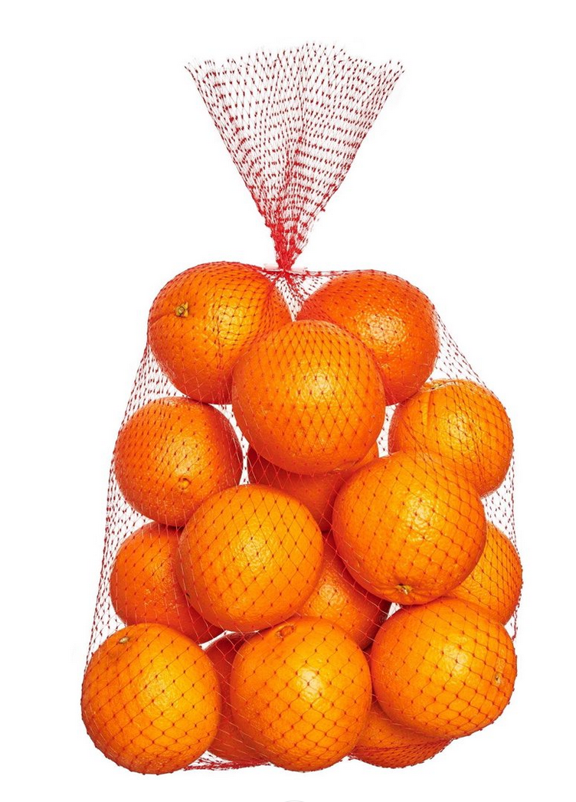
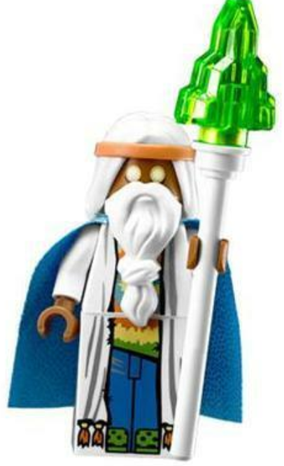






The Demand Curve
$9
$7.5
$5
$4.75
$4.5
$4
$2

Slide 13
Consumer Surplus
Let’s just assume that a bag of oranges costs $5
Consumer Surplus: Difference between maximum willingness to pay and price paid
$9
$7.5
Consumer Surplus: 4 + 2.5 = 6.5
$5
$5
$4.75
$4.5
$4
$2

Slide 14
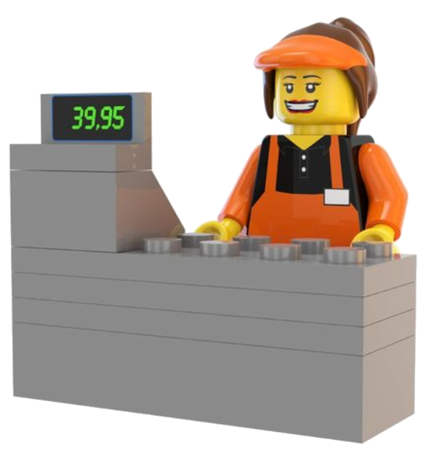
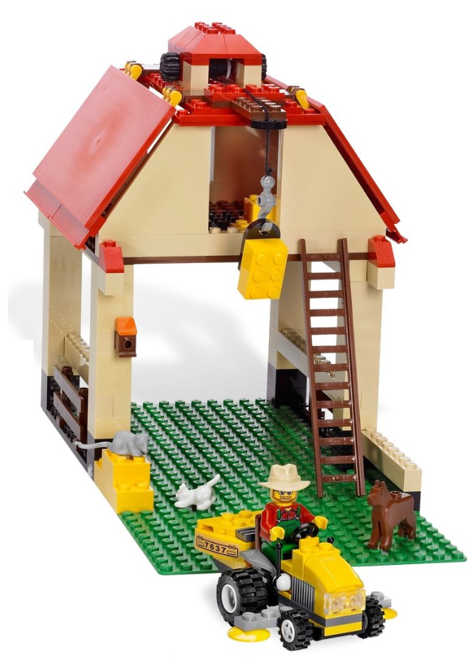




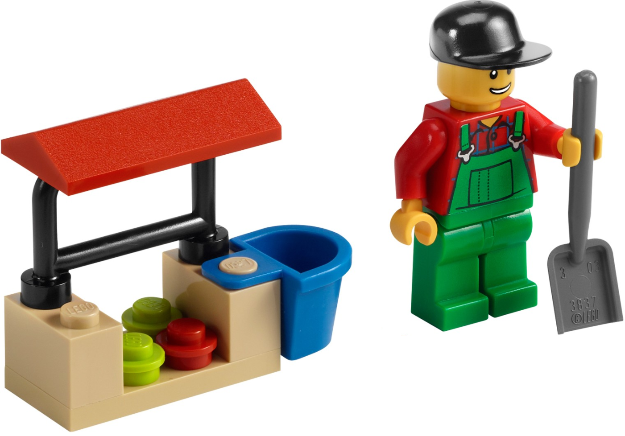
The Supply Curve
$9
$8
$7
$6
$5
$4
$3

Slide 15
Producer Surplus
Let’s just assume that a bag of oranges costs $5
Producer Surplus: Difference between minimum willingness to accept and price goods were sold
$9
Producer Surplus: 2 + 1 = 3
$8
$7
$6
$5
$5
$2
$1
$4
$3

Slide 16
How are Prices Set
$9
$9
$7.5
$8
$7
$5
$6
$5
$4.75
$4
$4.5
$3
$4
$2
At a price of $5 you have as many sellers as buyers:
If price was higher, there would be more people willing to sell than willing to buy
If price was lower, there would be more people willing to buy than willing sell

Slide 17
Gains from Trade
$9
$9
$7.5
$8
$7
$5
$6
$5
$4.75
$4
$4.5
$3
$4
$2
Because of the market, buyers and sellers could engage in transactions that left them better off:
Buyers that bought were willing to pay more for the oranges (at least 2 of them). They change $5 for something they value at more than $5
Sellers were willing to sell the oranges for less than $5 and received $5
Any other price than the market equilibrium would be inefficient

Slide 18
Economic Welfare and Market Efficiency
The consumer surplus and the producer surplus are measure of economic welfare
  Gains from trade that happen thanks to markets
We use them to evaluate how well/bad a market works
We will see that in other markets (for example when no money changes hands) we will need other ways of measuring market efficiency

Slide 19
Example PollEV
There are some students that want to sell their iClickers they no longer need, and some others that want to buy a used iClicker. Table below shows their WTP/WTA to sell/buy. What price would be efficient? (if this was a perfectly competitive market, what would be the equilibrium price)
Buyer | WTP | Seller | WTA
Alice | 20 | Gabriel | 5
Bob | 10 | Henry | 10
Carol | 15 | Isabelle | 15
David | 25 | Jacob | 18
Eleanor | 30 | Karen | 50
Freddy | 25 | Lucas | 30

Slide 20
Example PollEV
There are some students that want to sell their iClickers they no longer need, and some others that want to buy a used iClicker. Table below shows their WTP/WTA to sell/buy. What price would be efficient? (if this was a perfectly competitive market, what would be the equilibrium price)
Buyer | WTP | Seller | WTA
Eleanor | 30 | Gabriel | 5
Freddy | 25 | Henry | 10
David | 25 | Isabelle | 15
Alice | 20 | Jacob | 18
Carol | 15 | Lucas | 30
Bob | 10 | Karen | 50

Slide 21
Efficiency
Buyer | WTP | Seller | WTA
Eleanor | 30 | Gabriel | 5
Freddy | 25 | Henry | 10
David | 25 | Isabelle | 15
Alice | 20 | Jacob | 18
Carol | 15 | Lucas | 30
Bob | 10 | Karen | 50
What if had a mechanism that matches:
Eleanor w/ Lucas at a price of 30
Freddy w/ Jacob at a price of 21.5
David w/ Isabel at a price of 20
Alice w/ Henry at a price of 15
Carol w/ Gabriel at a price of 10
Would it be more or less efficient?

Slide 22
Efficiency
Buyer | WTP | Seller | WTA
Eleanor | 30 | Gabriel | 5
Freddy | 25 | Henry | 10
David | 25 | Isabelle | 15
Alice | 20 | Jacob | 18
Carol | 15 | Lucas | 30
Bob | 10 | Karen | 50
What if had a mechanism that matches:
Eleanor w/ Lucas at a price of 30 => Surplus = 0
Freddy w/ Jacob at a price of 21.5 => Surplus = 7
David w/ Isabel at a price of 20 => Surplus = 10
Alice w/ Henry at a price of 15 => Surplus = 10
Carol w/ Gabriel at a price of 10 => Surplus = 10
If we had just set a price of 19 => Total surplus would be 52, greater than 37

Slide 23

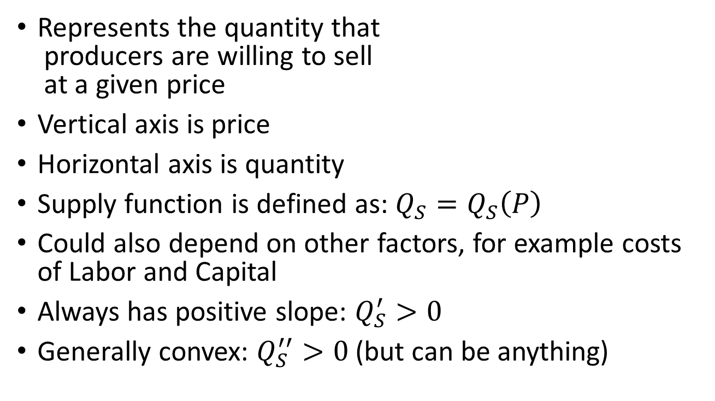
Supply Curve
P
$$P_{0}$$
Represents the quantity that
producers are willing to sell
at a given price
Vertical axis is price
Horizontal axis is quantity
Supply function is defined as: $Q_{S}=Q_{S}\left(P\right)$
Could also depend on other factors, for example costs of Labor and Capital
Always has positive slope: $Q_{S}^{′}>0$
Generally convex: $Q_{S}^{′′}>0$ (but can be anything)
Q

Slide 24

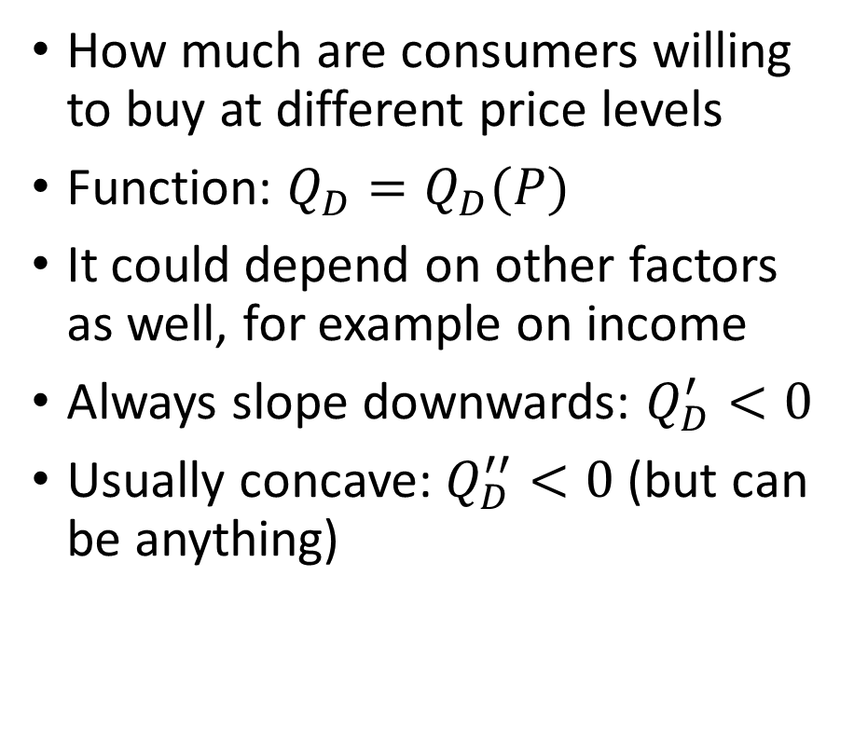

Demand Curve
How much are consumers willing to buy at different price levels
Function: $Q_{D}=Q_{D}(P)$
It could depend on other factors as well, for example on income
Always slope downwards: $Q_{D}^{′}<0$
Usually concave: $Q_{D}^{′′}<0$ (but can be anything)
P
$$P_{0}$$
$$Q_{0}$$
Q

Slide 25


Supply Curve: What Happens if Cost of Raw Materials go Down?
P
B
A
$$P_{e}$$
$$Q_{e}$$
Q

Slide 26


Demand Curve: What Happens if Income Increases? A or B?
A
P
$$P_{0}$$
B
$$Q_{0}$$
Q

Slide 27


The Market Mechanism
P
$$P_{e}$$
$$Q_{e}$$
Q
Market Mechanism: Tendency in a market for the price to adjust until the market clears
  No one wants to buy an extra unit at the equilibrium price
  No one wants to sell an extra unit at the equilibrium price

Slide 28

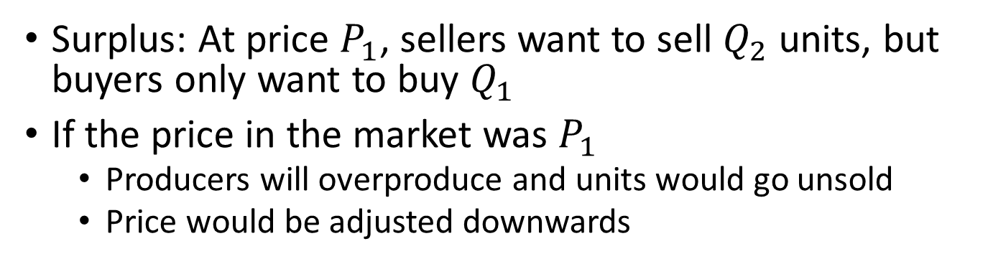

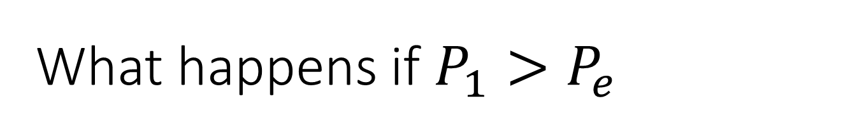

What happens if $P_{1}>P_{e}$
P
$$P_{1}$$
Surplus
$$P_{e}$$
$$Q_{1}$$
$$Q_{e}$$
$$Q_{2}$$
Q
Surplus: At price $P_{1}$, sellers want to sell $Q_{2}$ units, but buyers only want to buy $Q_{1}$
If the price in the market was $P_{1}$
  Producers will overproduce and units would go unsold
  Price would be adjusted downwards

Slide 29

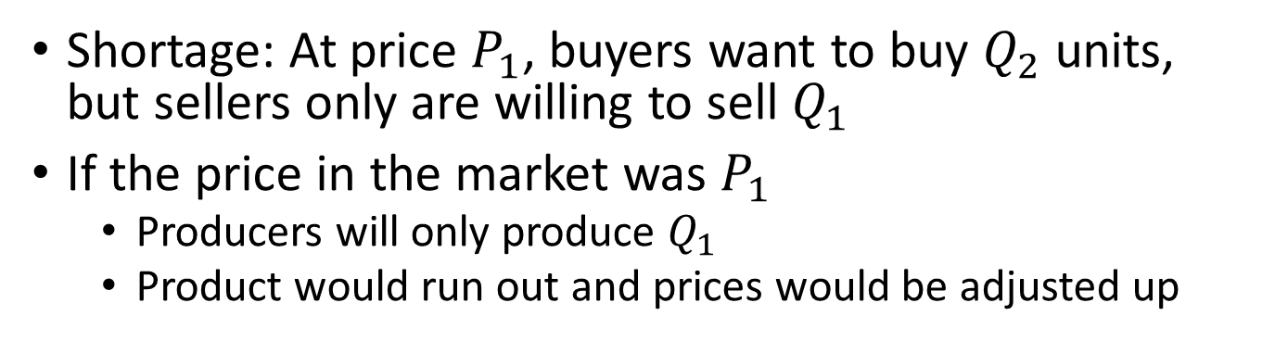

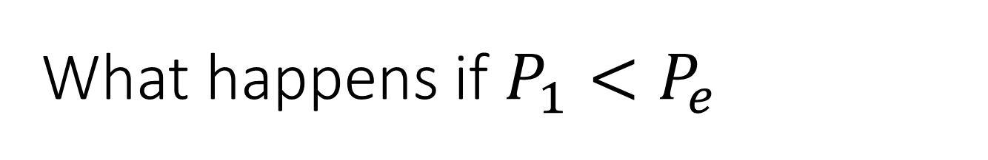

What happens if $P_{1}<P_{e}$
P
$$P_{e}$$
$$P_{1}$$
Shortage
$$Q_{1}$$
$$Q_{e}$$
$$Q_{2}$$
Q
Shortage: At price $P_{1}$, buyers want to buy $Q_{2}$ units, but sellers only are willing to sell $Q_{1}$
If the price in the market was $P_{1}$
  Producers will only produce $Q_{1}$
  Product would run out and prices would be adjusted up

Slide 30
Consumer Surplus
P
Consumer
Surplus
S
Consumer Surplus is the area between the demand curve and the price
5
D
Q

Slide 31
Producer Surplus
P
S
Producer Surplus is the area between the supply curve and the price
5
Producer
Surplus
D
Q

Slide 32
Producer Surplus
P
Consumer
Surplus
S
5
Producer
Surplus
D
Q

Slide 33
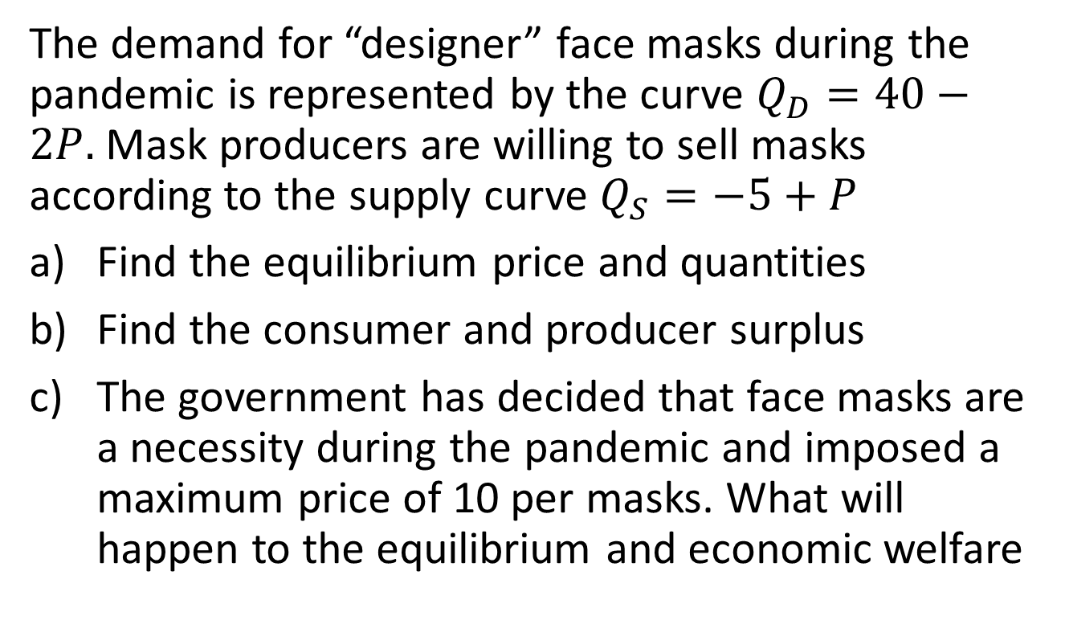
Example
The demand for “designer” face masks during the pandemic is represented by the curve $Q_{D}=40−2P.$ Mask producers are willing to sell masks according to the supply curve $Q_{S}=−5+P$
Find the equilibrium price and quantities
Find the consumer and producer surplus
The government has decided that face masks are a necessity during the pandemic and imposed a maximum price of 10 per masks. What will happen to the equilibrium and economic welfare

Slide 34




Producer/Consumer Surplus
P
20
S
$$CS=\frac{\left(20−15\right)∗10}{2}$$
$$Q_{S}\left(P\right)=−5+P⇒P=5+Q_{S}$$
$$Q$$
15
$$PS=\frac{\left(15−5\right)∗10}{2}$$
D
$$Q_{D}\left(P\right)=40−2P⇒P=20 −\frac{Q_{D}}{2}$$
5
10
Q
1. Find equilibrium price, and equilibrium quantity:$Q_{S}=Q_{D}$
$−5+P=40−2P⇒P=15, { Q}_{S}\left(15\right)=Q_{D}\left(15\right)=$ 10
2. Find where demand and supply curve intersect vertical axis (Set Q=0 above)
3. Calculate areas corresponding to CS and PS

Slide 35


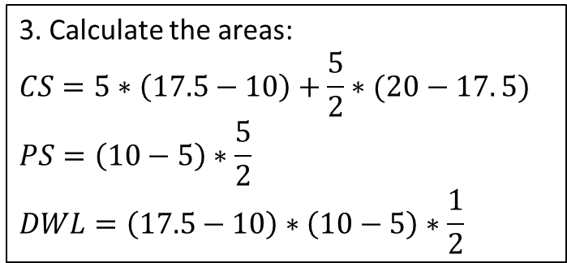


Price Ceiling
P
2. Find this point: $P=20 −\frac{5}{2}=17.5$
20
S
$$Q_{S}\left(P\right)=−5+P⇒P=5+Q_{S}$$
3. Calculate the areas:
$$CS=5∗\left(17.5−10\right)+\frac{5}{2}∗(20−17. 5)$$
$$PS=\left(10−5\right)∗\frac{5}{2}$$
$$DWL=\left(17.5−10\right)∗\left(10−5\right)∗\frac{1}{2}$$
CS
DWL
15
10
PS
D
$$Q_{D}\left(P\right)=40−2P⇒P=20 −\frac{Q_{D}}{2}$$
5
10
Q
1. Find this point: $Q_{S}\left(10\right)=−5+P=5$

Slide 36
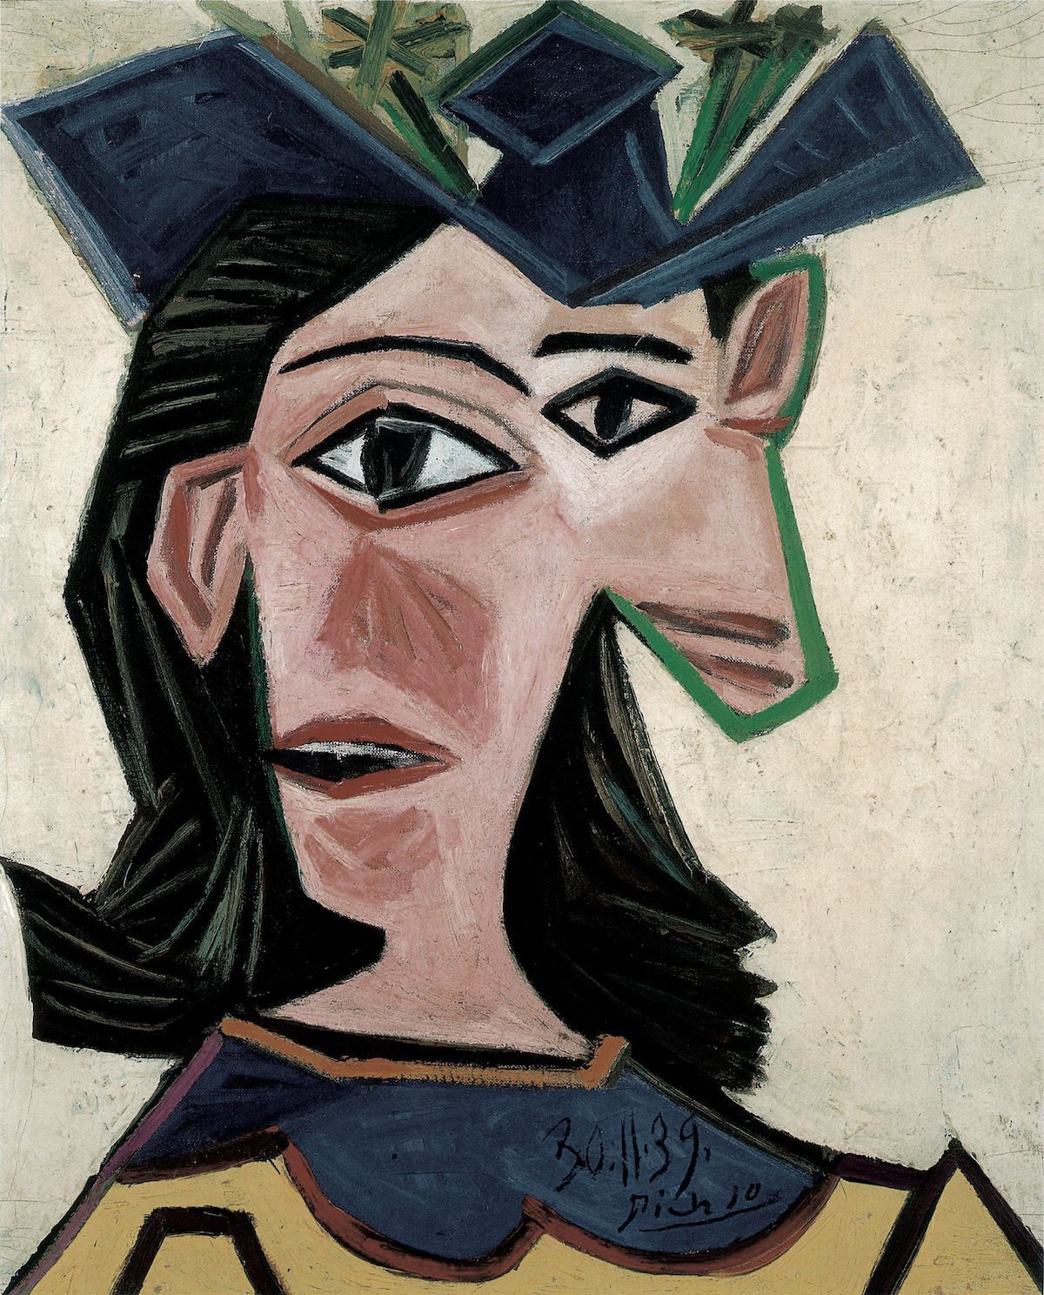
Special Case 1
There is one Picasso painting for sale
Seller wants to get at least $50MM
Buyer 1 wants to pay at most $115MM and Buyer 2 at most $200MM
P
200MM
All the information is private. Nobody knows others willingness to accept and willingness to pay. How do we set the price?
115MM
50MM
1
Q
Image: Pablo Picasso, Buste de femme au chapeau (Dora), 1939. Fondation Beyeler, Riehen/Basel, Sammlung Beyeler.
© Succession Picasso / 2019, ProLitteris, Zürich. Photo by Peter Schibli.

Slide 37
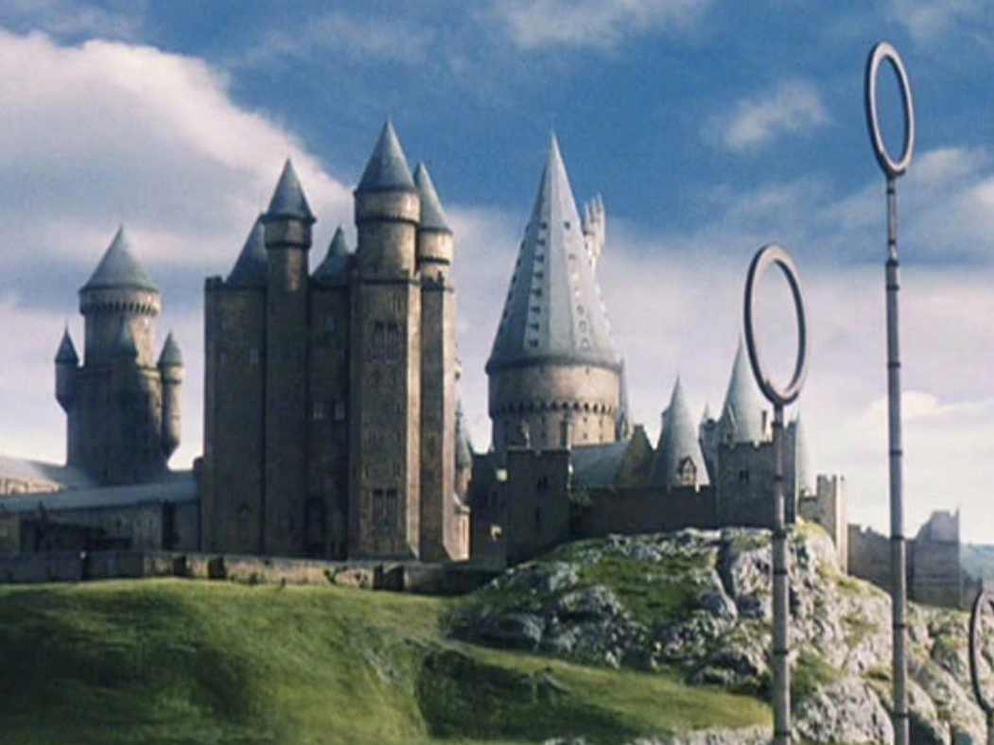
Special Case 2
Hogwarts Admissions:
  40k Applicants for 2k spots
  Cost ~$70k/year to attend
Should Hogwarts raise the cost of attendance until number of applicants match number of spots?

Slide 38
Market Mechanism Summary
Supply Curve: How much sellers are willing to sell at a given price
Demand Curve: How much buyers are willing to buy at a given price
Market: Institutions where buyers and sellers agree on a price
Market Mechanism: Tendency in the market to adjust prices until the market clears (equilibrium)
Consumer Surplus: Difference between what buyers are willing to pay and how much they pay
Producer Surplus: Difference between how much sellers are paid, and the minimum they were willing to accept

Slide 39
Let’s play a game
Next week I will release problem set 1
In this game, I will give you the option to collude or to defect:
  If everyone here today “colludes”, everyone will get a 10 points bonus in PS1
  If everyone but one person “colludes”, the person that “defects” gets a 50 points bonus, and the rest gets 0
  If more than one person defects, no one gets any bonus

Slide 40
What is Game Theory
Is a set of tools to analyze strategic decision making for a group of actors and predict outcomes
Strategic decision making refers to decision where the actions taken by one actor influences the actions and outcomes of other actors
It has been used in many settings, including economics, military studies, political science, etc.
We will use it because in markets and network industries the actions and outcomes of different players are influenced by the network

Slide 41
Take Away
We discussed thick markets and how they lead to an equilibrium of demand and supply
  And the equilibrium was efficient as it maximizes economic welfare
We started talking about game theory
  How a strategic (or normal) form game is defined
  How it is usually represented in matrix form
These two concepts will be important throughout the semester:
  We want markets to be efficient. With prices and WTA/WTP is easy to determine. Without prices we will have to use different concepts.
  When studying markets, we want a framework to analyze agents’ behavior. Game theory is ideal for this.

